Slide 1



GIZ YOUTH ENTREPRENEURSHIP PROGRAM · PITCH SHOWCASE
Cheapify
A Smart Multi-Seller Marketplace
Founder: Shakir Bashar
capa.auk
CAPA AUK
capa@auk.edu.krd

Slide 2



PART 1 · THE PROBLEM
Price Disparity & Market Fragmentation
ACROSS APPS & PAGES
INSIDE PLATFORMS
DIRECT MESSAGES
Arbitrary Disparity
Intra-Platform Chaos
The "How Much?" Friction
Identical items sell at conflicting prices across social media pages and apps (e.g., Miswag, Simma).
Duplicate listings for the exact same SKU appear on multi-seller platforms like iBazzar with inconsistent pricing.
Buyers waste hours in repetitive direct messages without price clarity.

Slide 3



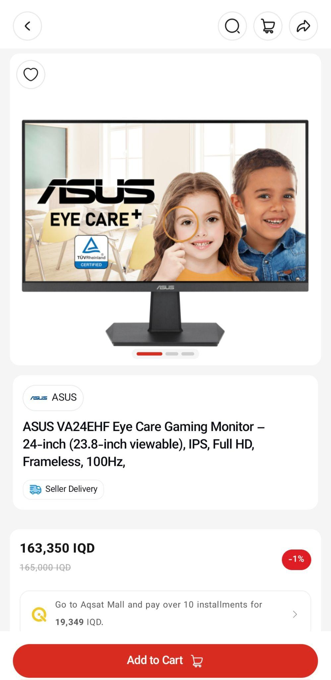
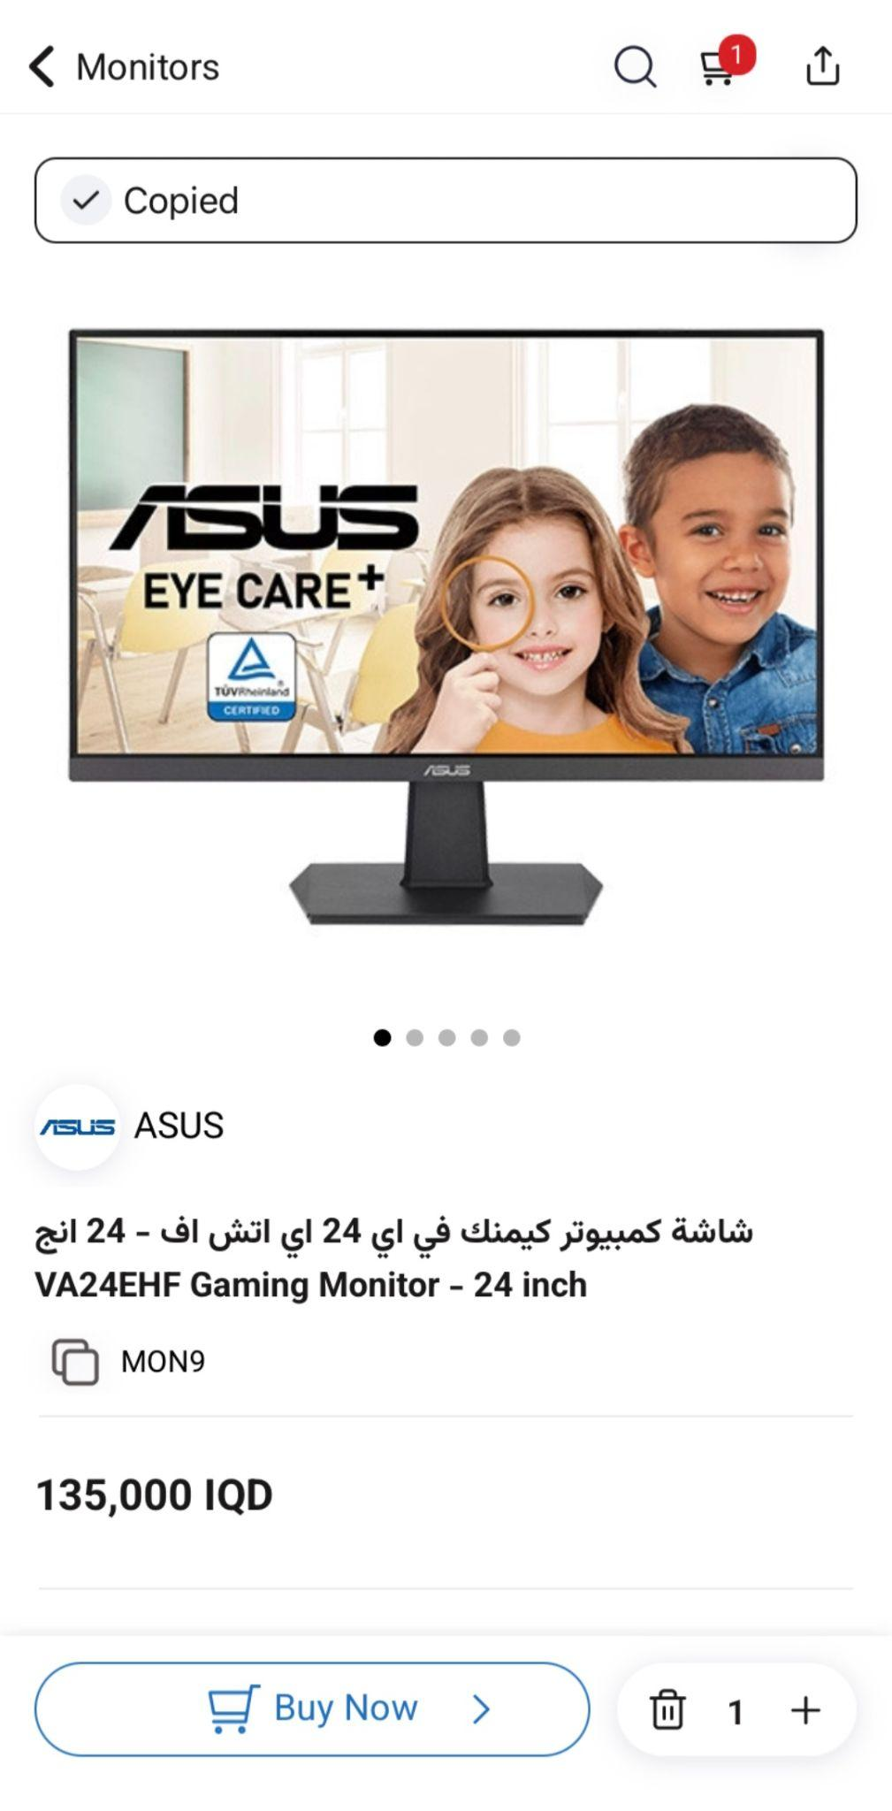
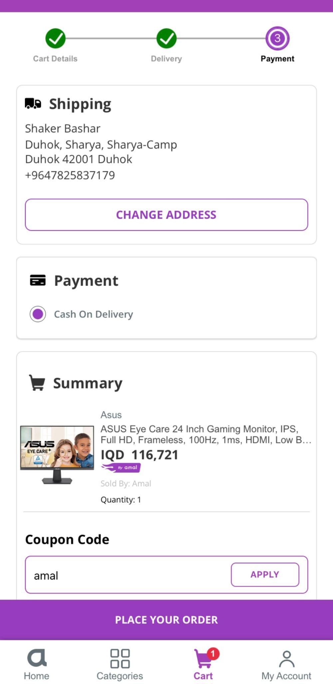
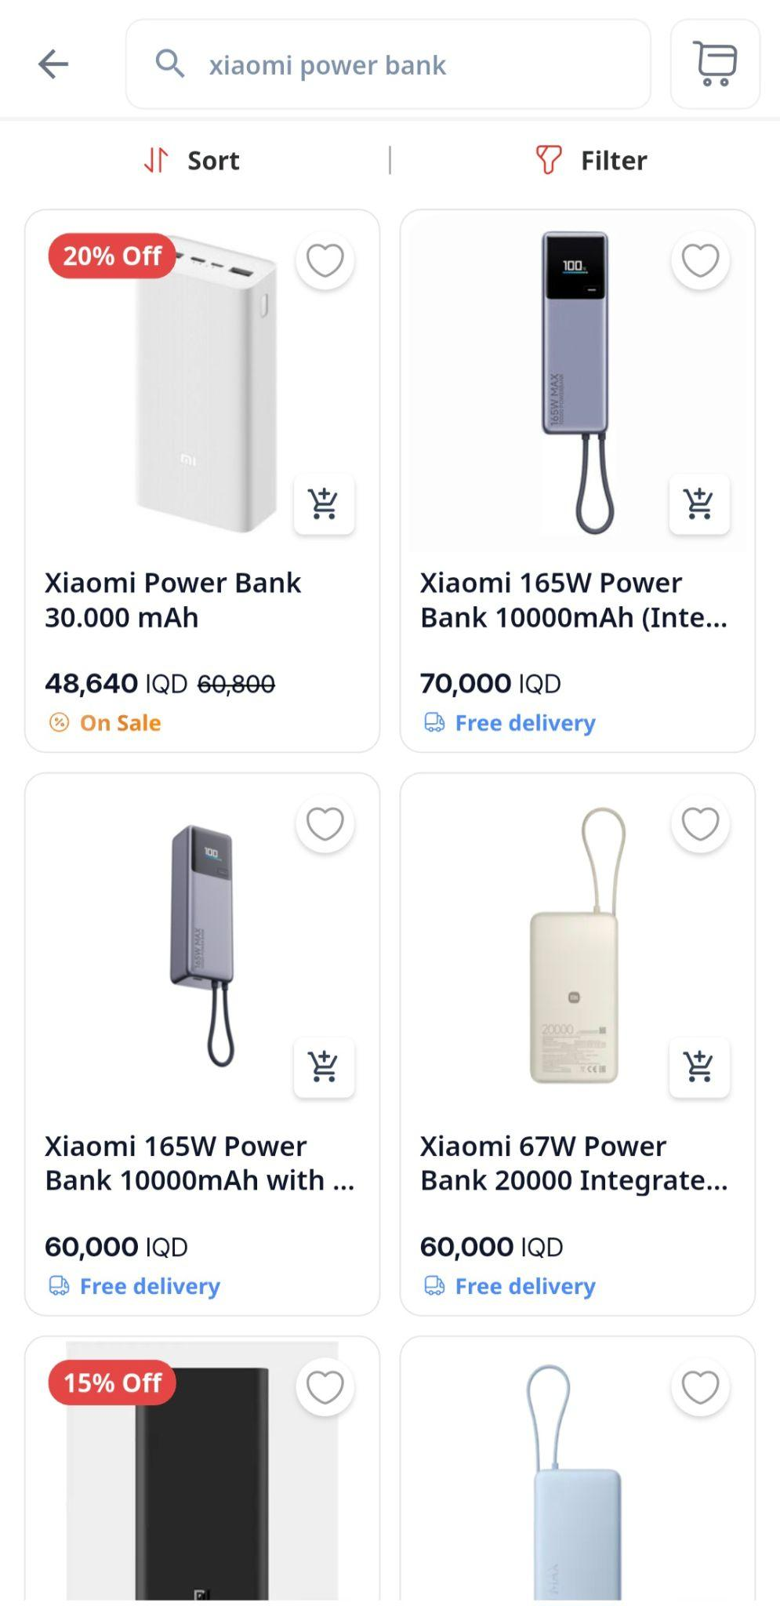
PART 1 · EVIDENCE
Proof of Price Inconsistency in the Market
STORE A
STORE B
STORE C
INSIDE IBAZZAR (SAME APP)
ASUS Gaming Monitor
ASUS Gaming Monitor
ASUS Gaming Monitor
Xiaomi 165W (Same SKU)
163,350 IQD
135,000 IQD
116,721 IQD
70k vs 60k IQD

Slide 4


PART 2 · THE SOLUTION
Cheapify: Transparent & Smart Commerce
SINGLE SKU
FAIR RANKING
SMART PRICING
Unified Product Pages
Best-Price Prioritization
Live Merchant Alerts
Aggregates every seller under a single product card, eliminating duplicate clutter.
Automatically displays the lowest price and highest-rated verified seller first.
Alerts sellers when competing listings drop lower, driving organic fair deals.

Slide 5

PART 3 · TARGET CUSTOMERS
Who Benefits: Shoppers & Local Merchants
Everyday Deal-Seekers
Local Retail Merchants
Consumer Segment (18–35 Years Old)
Physical Store Owners & Social Media Shops
Behavior: Everyday online shoppers, savvy deal-seekers, and budget-conscious buyers.
Audience: Small & medium retail stores seeking digital order volume.
Demographics: Young adults and working professionals across major Iraqi & KRI cities.
Pain Point: Custom e-commerce apps are too expensive to build and maintain.
Goal: Transparent price comparison in seconds without overpaying or endless DMs.
Goal: Ready-made digital storefront with steady buyers and no heavy cuts.

Slide 6
PART 3 · VALUE PROPOSITION
Clear & Measurable Value Across the Market
FOR SHOPPERS
FOR MERCHANTS
FOR THE MARKET
Guaranteed Savings
Sales & Reach
Standardized Trust
Saves money instantly, avoids retail markups, and eliminates hours spent messaging sellers.
Instant access to active buyers, automated order management, and live pricing insights.
Replaces chaotic direct messaging with dependable checkout, courier integration, and ratings.

Slide 7
PART 4 · BUSINESS LOGIC
Delivery Operations & Revenue Model
Fulfillment & Operations
Revenue Generation
Lean Logistics Infrastructure
Tiered Pricing Model
In-House Platform: Architecture built directly by founder, keeping dev costs low.
Active Tiers: <9k IQD (5%) · 10k–99k IQD (Flat 1,000 IQD) · 100k–499k IQD (2%), etc.
Courier Integration: Local dispatch partners handle merchant pickup and delivery.
Fair Adoption Model: Replaces heavy platform commissions to accelerate sign-ups.
Local Payments: Seamless Cash on Delivery (COD) plus FastPay, FIB, and Qi Card.
Growth Streams: Featured product placement and merchant analytics.

Slide 8


Smart Deals. Verified Sellers. One App.
Transparent · Smart · Reliable
Thank You
Cheapify
capa.auk
CAPA AUK
capa@auk.edu.krd

